Slide 1
Practice #3
Create Performance Task

Slide 2
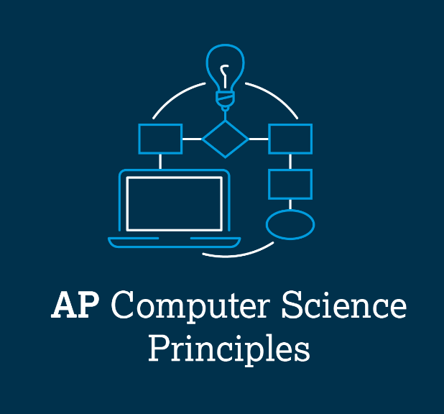
AP CSP Create Performance Task
Part of the AP Exam is to create a program that meets specific requirements:
Creates a list
Uses a list in a meaningful way
Has a function with a parameter
  Parameter affects function execution
Function has:
  If statement
  Loop

Slide 3
AP CSP Create Performance Task
Things to know about the Create PT:
You can work with a partner
Your classmates can help you
Your teacher cannot help you
You cannot use an assigned program for your project, but it can be similar
You will be given 9 hours of class time to work on the project

Slide 4
AP CSP Create Performance Task
The Create PT is like a remix project:
Start small and add components.
Start with what you know.
Don’t try something new that you don’t know how to do.
This isn’t a time to learn something new, but to show what you know how to do.

Slide 5
AP CSP Create Performance Task
The Create PT is like a remix project:
During a remix, you looked at completed programs and reviewed what you learned.
You either added to or created a program similar to your completed programs.
You can do the same thing for the Create PT.
Let’s look at a program from a mission and remix it to meet the requirements of the Create PT.

Slide 6
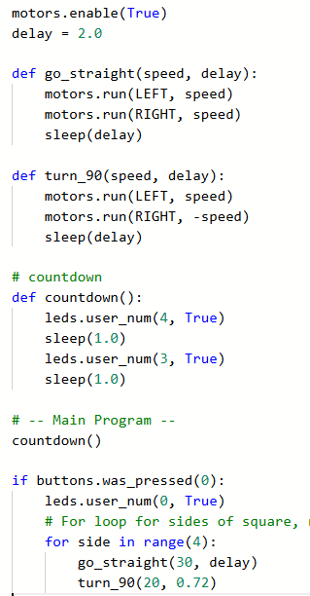
Practice #3
In CodeSpace, go to the Sandbox.
Open the project: WhatIf_loops
Go to File Save As… and rename the file PT_CodeBot_Practice3
What PT requirements does it meet?
What PT requirements does it lack?

Slide 7


Practice #3
PT Requirements
Creates a list
Uses a list in a meaningful way
Has a function with a parameter
  Parameter affects function execution
Function has:
  If statement
  Loop

Slide 8
Practice #3
This project barely meets one requirement.
But can you add code to it to meet the requirements?
Go to the Activity Guide and write down some possible program modifications.

Slide 9

Practice #3
Let’s start by creating some lists.
Notice the only difference between the two squares is the turning.
  To turn right, the right wheel has a negative speed.
  To turn left, the left wheel has a negative speed.
Create two lists: one for the wheel that always moves forward, and another list for the wheel that goes backward during turns.
The information comes from the function calls:

Slide 10
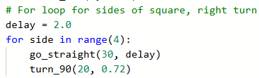

Practice #3
Create another list for the delays.
These coordinate with the ‘bots movements: Forward, turn, forward, turn, etc.

Slide 11
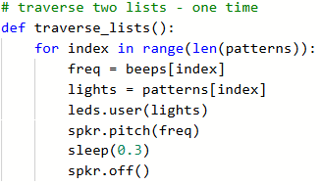
Practice #3
You will traverse the lists to move the ‘bot.
Open the PythonLists2 program.
Review the code for traversing two lists.
You will be using similar code in your new project.

Slide 12
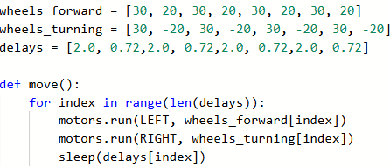
Practice #3
Modify the go_straight() function to traverse the list.
Change the name.
Traverse the list using index.
Use a list for left wheel, another for right wheel, and the third for the delay
Delete the turn_90() function.

Slide 13
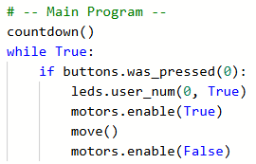

Practice #3
Change the main program for testing.

Slide 14
Practice #3
Revisit the PT Requirements:
Creates a list
Uses a list in a meaningful way
Has a function with a parameter
  Parameter affects function execution
Function has:
  If statement
  Loop

Slide 15
Practice #3
Now most of the Create PT requirements are met.
How can you add a parameter and if statement to the move() function?
The current move() function only turns one way.
The original program gives the option of right or left turns.
Add a parameter that assigns the lists, determined by the button press.

Slide 16
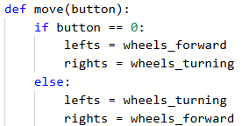
Practice #3
Add a parameter for the button that is pressed.
Use the parameter in an if statement to assign the lists.

Slide 17
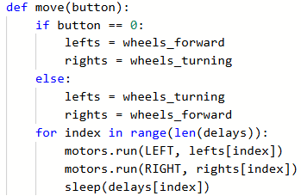
Practice #3
Use the assigned lists in the for loop:

Slide 18
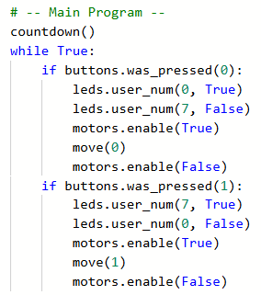
Practice #3
Complete the main program for two button presses.

Slide 19
Practice #3
Revisit the PT Requirements:
Creates a list
Uses a list in a meaningful way
Has a function with a parameter
  Parameter affects function execution
Function has:
  If statement
  Loop

Slide 20
Practice #3
Now that you have seen an example of a remix from the WhatIf program, can you think of any other ways to remix the project for the Create PT?
Go to the Activity Guide and write down any more ideas you have for modifications.

Slide 21
Practice #3
Final considerations.
Your program needs to have input and output.
  Be prepared to explain the input and output of this program.
  This program has input through button presses.
  In a video, you want to show the button presses, or add a caption that explains the input
  The output is the lit LEDs and the CodeBot moving in a square.
  In a video, you want to show the movement and LEDs.

Slide 22
Final considerations.
Your program needs to have a specific purpose and intended user.
  The purpose of this program could be explained as a learning tool for children to help them learn left and right.
  The function is to draw a square turning left or right.
  The intended user is a young child who want to use a physical device to learn left and right.

Slide 23
Practice #3
Final considerations.
You need to explain how the lists manage complexity.
  The lists allow you use less code. Instead of a for loop with two function calls, you call one function with a single loop that traverses the list.
  The lists allow you to change the data easily, without having to go in the code to do it. For example, if you want a triangle instead of a square, you just create and use different lists, but you don’t have to change the code in the function.
  If you want a smaller square, you create and use a different list for the delays, but you don’t have to change the code in the function.

